Slide 1
Good Fences Make Good Neighbors
Experiences in Hybrid Cloud Integration – Lightning Round
November 16, 2017
Bryan Hopkins
University of Pennsylvania

Slide 2


Who is this guy?
?
Bryan Hopkins – University of Pennsylvania
App Dev Lead for Penn’s Cloud First team
Past Lives:
Cold Fusion developer (ewww)
Java developer
Architect on our frameworks team
Infrastructure team lead for our initial Banner implementation
Technology Coordination lead for campus initiatives
Keep it simple, with the support team in mind
“The State Department within the SWAT Team”
Notes:
So who is this guy standing in front of you to give DevOps relationship advice?
Hi, I’m Bryan Hopkins from the University of Pennsylvania. I’m the team lead for the application delivery side of our cloud team.
My first IT job was as a Coldfusion 4 developer at an e-commerce chop shop, and from there have worn hats as a Java developer, frameworks architect, and infrastructure team lead. So while Dev and Ops are very much separate at Penn traditionally, I’ve been on both sides.

Slide 3
Core Cloud First Team In Abesntia
Not everyone is speaking, but this is everyone’s work
Tim Bouffard, Application Architect
Sam Donnelly, Senior Application Developer
Justin Ettore, Systems Architect
Dane Fetterman, IT Architect
Tiffany Hanulec, IT Technical Director
Janet Lind, IT Director
Anome Mammes, Senior Application Developer
Lisa McBriar, Senior Business Systems Analyst
Matt Schleindl, Application Architect
Eric Snyder, Senior IT Manager
Namitha Venkatesh, Senior IT Manager
Mathias Wegner, Network Engineer

Slide 4

What Does “Cloud Native” mean to us?

Slide 5
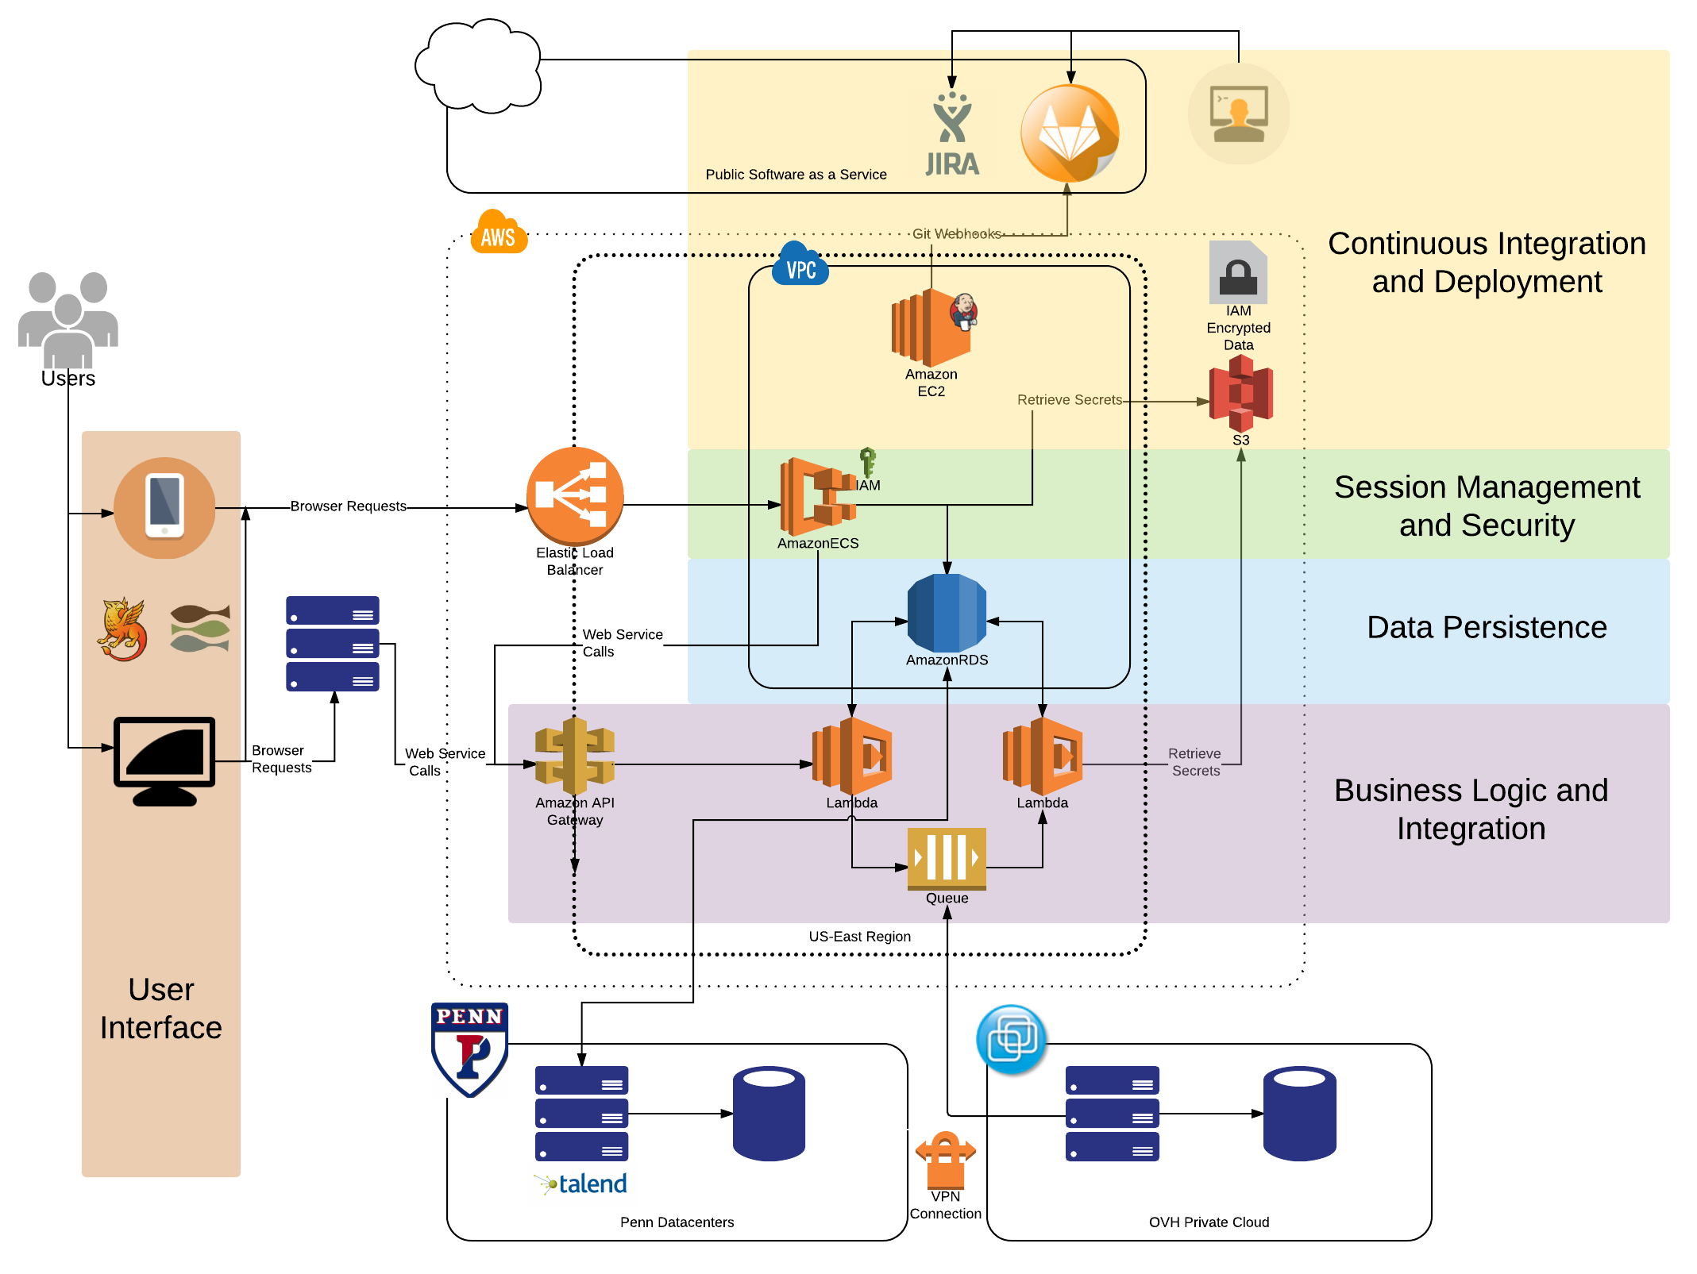
https://www.isc.upenn.edu/cloud-development-architecture-roadmap

Slide 6

Those bottom pieces remain pretty important!

Slide 7









Case Study 1: Online Giving Portal
Data ETL
To PostgreSQL RDS
Fundraising metadata
To S3 / Cloudfront
PeopleSoft-managed images
To Oracle on Prem
Transactions
All with Talend
Configuration not code
Near real-time
DAR Apps
Donate
Pledge
Volunteer
PeopleSoft, Data Warehouse
DAR Services

Slide 8





Case Study 2: Service Ordering
VDI and Backup service requests
On Prem PowerShell
Add users to AD Groups
Provision services
AWS SQS Message Bus
Configuration not code
JSON Metadata
Easy to swap out VDI solutions
User Requests
Resolution

Slide 9




Case Study 3: Device Registration
Internet of Things Network Registration
On Prem PacketFence Infrastructure
Register Devices
Manage Permissions
RESTful API Calls
API Key protection
Mobile App in the Cloud
Network managed on Prem
Registrations

Slide 10
Key Takeaways
Cloud First is not Cloud Only
Hybrid Integrations can vary based on
Architecture of the product
Use case
Cloud First transformation
A lot less scary when it’s supporting some on prem workloads too!

